Slide 1
Competitive Cyber Security Organization
HackPSU – Password Cracking
By attending today’s meeting you acknowledge that you may be photographed or recorded for club use

Slide 2

Who we are / What we Do
Mentor
Teach a variety of cybersecurity topics
Empower students with technical and non-technical skills
Hands-on time to practice
Foster self-learning and continual improvement
Cultivate community of talented individuals
Compete
Represent Penn State in cyber competitions
Travel to competitions and conferences
Network and build your resume
Notes:
Josh

Slide 3


Comms
Discord is our primary chat platform
Announcements
Events
Be sure to select interests
Cool place to hang out
https://bit.ly/ccso-discord
Notes:
Brendan

Slide 4
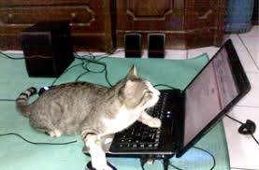
Objectives
How are passwords stored?
What is password cracking?
What if I can't crack a password?
Let's get crackin

Slide 5
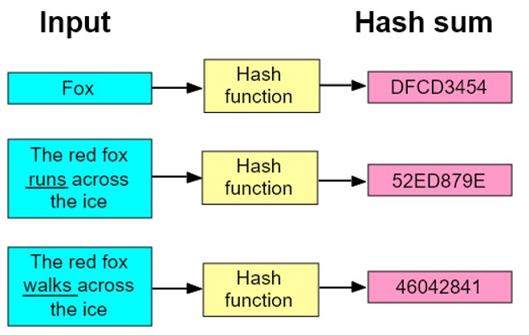
How are Passwords Stored?
Passwords aren't stored in plain text
Stored as hashes
Like encryption, but slightly different
Turns input into unique gibberish

Slide 6
What Makes a Good Hash
One-Way
Cannot determine input from hash value
Diffusion
“Avalanche effect”
Deterministic
Re-calculating the hash yields same result

Slide 7

Hashing Applications
Modern hashing uses:
Storing passwords securely
Checking data integrity
Fingerprinting Malware

Slide 8
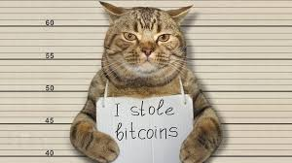
What is Password Cracking?
Attempting to reconstruct the plaintext of a password hash
Different methods:
Brute forcing
Dictionary attacks
Rainbow table attacks

Slide 9
Brute Forcing
Trial and error method
Trying every possible combination of characters
Can be refined with extra criteria
Length of 7
Must include a special character

Slide 10
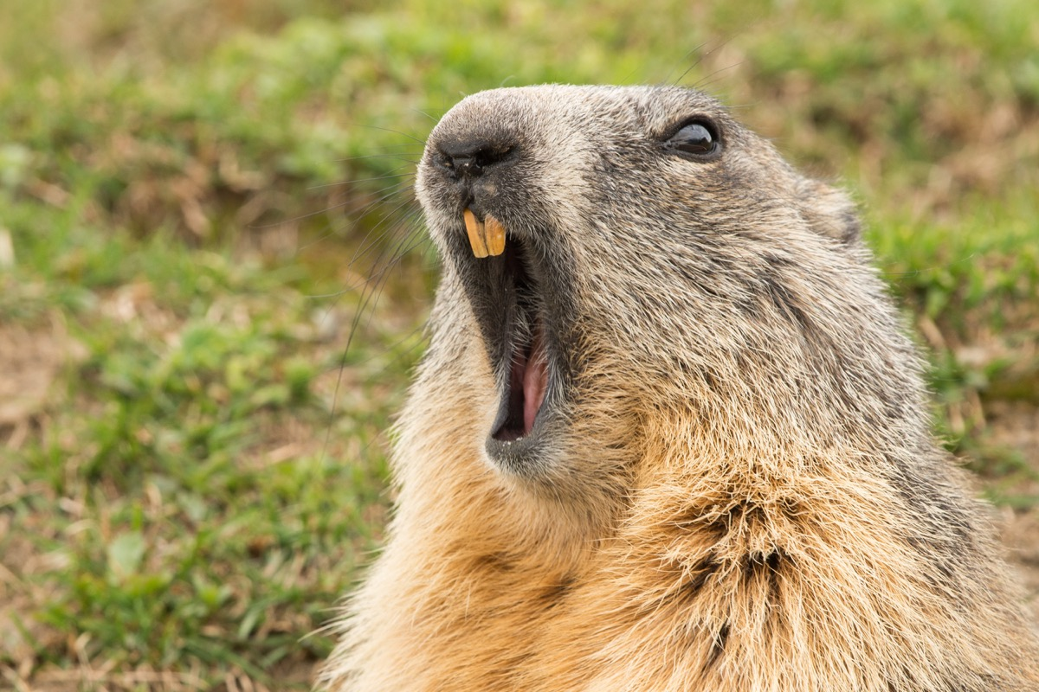
Dictionary Attacks
Similar to a brute force
Compares a list or dictionary of passwords to the hash

Slide 11
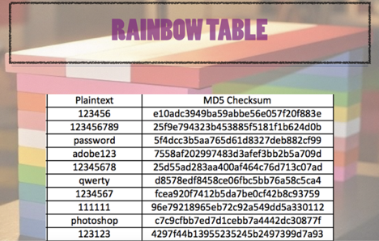
Rainbow Table Attacks
Faster than a dictionary attack
Utilizes a table of passwords and their hashes
Skips having to hash each value in a dictionary

Slide 12
Social Engineering
Sidestepping the cracking process
Manipulating users into providing credentials
Different methods:
Phishing
Vishing
Spearphishing

Slide 13
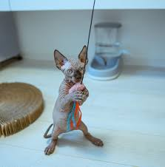
What if I can’t crack it?
Passing the hash
Works in some environments like windows authentication

Slide 14
Lets Get Crackin
https://github.com/CyberLions/Password-Cracking-HackPSU

